Slide 1


AMATH463: Fluid Dynamics
Final Project: Hurricanes
Petra M. Duff & David René
Goal Outline
Study the fluid dynamics of the formation of hurricanes.
Focus on computational analysis.
Provide a simple 3D model.
Study the effects of physical variables on the formation process (Temperature, location, etc.)
Challenges
Implementation of Coriolis forces.
Creation of 3D computational model.
Numerically solve PDEs.

Slide 2
AMATH463: Fluid Dynamics
Final Project
Petra M. Duff & David René
An Analysis of Hurricanes

Slide 3

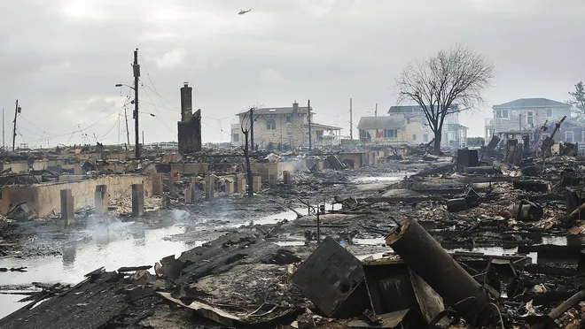
AMATH463: Fluid Dynamics
Introduction
Petra M. Duff & David René
Meteorology is a science that dates back thousands of years but due to fast advances in computer science during the World Wars as well as efforts from Lewis F. Richardson, Vilheln Bjernkes and John von Neumann, we are now able to use computers to provide predictions on incredibly complex systems such as hurricanes.
John von Neumann, from “The Man from the Future”
Ocean flows and air flows within the atmosphere have life-changing impacts on people’s lives: in the U.S. alone, there have been approximately $7 trillion in damages from hurricanes and other climate phenomena, excluding casualties.
(NOAA Office for Coastal Management)
Damages from hurricane Florence in 2018, USA Today

Slide 4
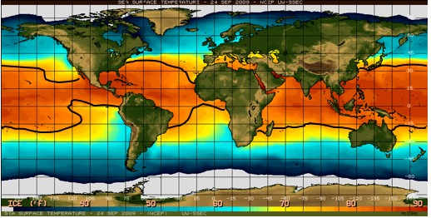
AMATH463: Fluid Dynamics
Conditions for hurricane formation
Petra M. Duff & David René
A sea temperature of at least 26.5 °C
A proper temperature gradient in height
Sufficient water vapor in the middle of the troposphere
Sufficient distance from the equator
Little vertical wind shear
Sea surface temperature around the world

Slide 5
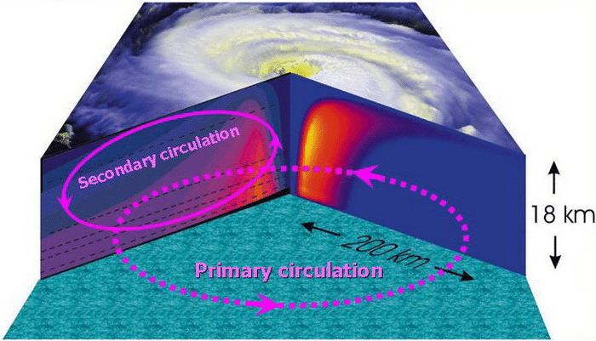
AMATH463: Fluid Dynamics
Circulations
Petra M. Duff & David René
Primary circulation:
Pressure gradient force
Centrifugal force
Coriolis force
Friction
Secondary circulation:
Fluid mechanics
Thermodynamics

Slide 6
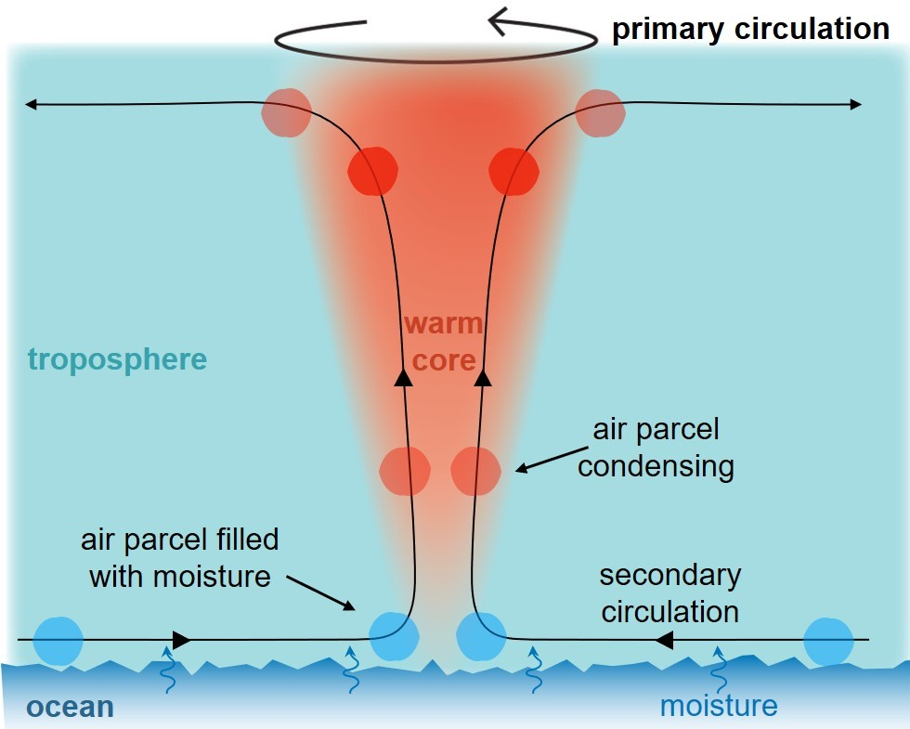
AMATH463: Fluid Dynamics
Overview of secondary circulation
Petra M. Duff & David René

Slide 7
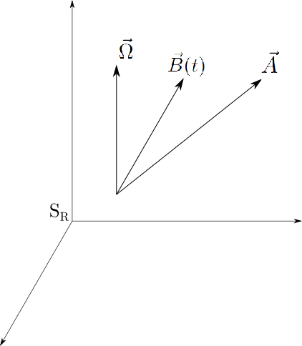
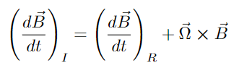
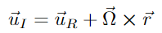
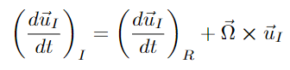
AMATH463: Fluid Dynamics
Primary circulation
Petra M. Duff & David René
We take in account the rotation of the Earth and look at how a given vector varies in the inertial state as a function of the rotational state:
Setting this vector to be a position vector gives us the following:
And reusing our first equation with our velocity vector gives:

Slide 8
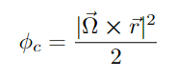
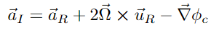
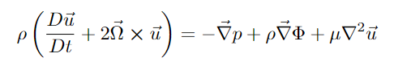
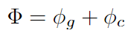
AMATH463: Fluid Dynamics
Primary circulation
Petra M. Duff & David René
Using this first equation within the second yields this relation between our inertial acceleration and rotational acceleration:
where
We can insert this in the Navier-Stokes equation to obtain an equivalent in the rotating frame:
with

Slide 9
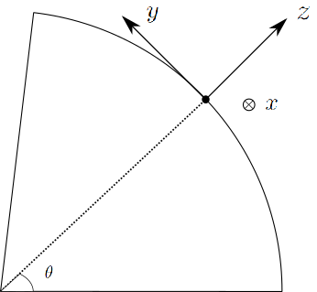
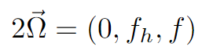
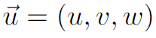
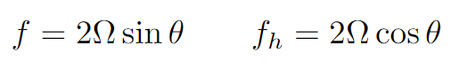
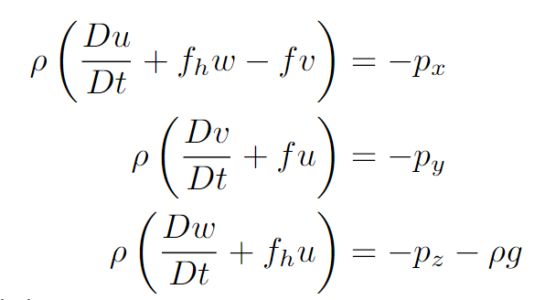
AMATH463: Fluid Dynamics
Primary circulation
Petra M. Duff & David René
We can then make an f-plane approximation:
We input these in our NS equation:

Slide 10
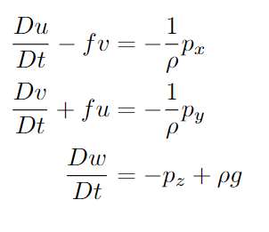
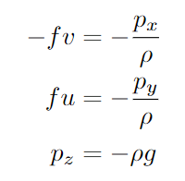
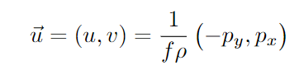
AMATH463: Fluid Dynamics
Primary circulation
Petra M. Duff & David René
This approximation for large scale flows allows us to neglect fh terms, giving:
We can then assume a geostrophic balance in the system:
We can isolate our planar flow vector:

Slide 11
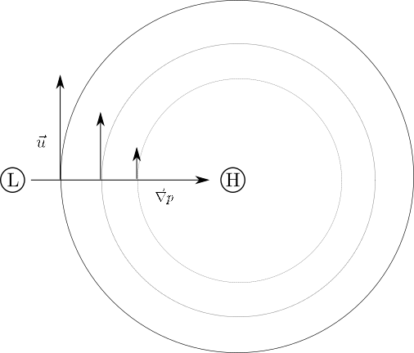
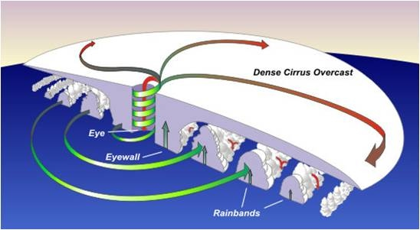
AMATH463: Fluid Dynamics
Primary circulation
Petra M. Duff & David René

Slide 12
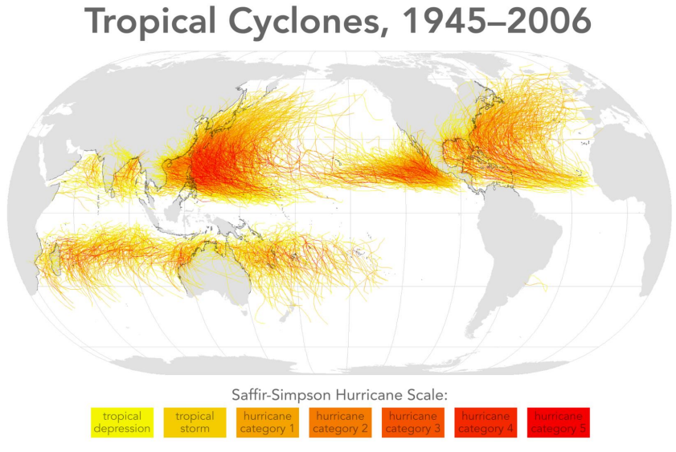
AMATH463: Fluid Dynamics
Effects of beta drift on circulation
Petra M. Duff & David René
Beta drift: drift on the hurricane system caused by the advection of the background potential vorticity field.
Typically pushes hurricane westward and poleward.
(AMS)

Slide 13
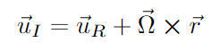
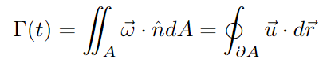
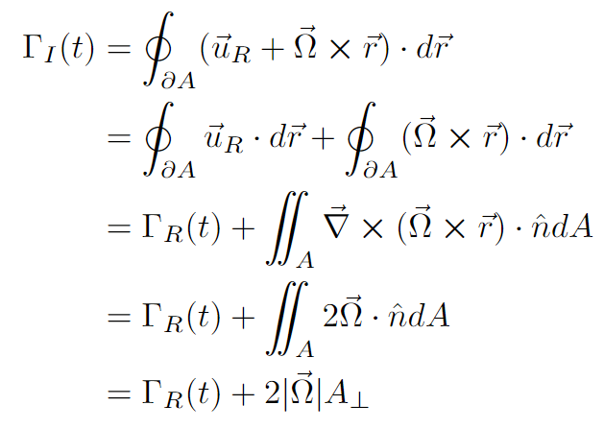
AMATH463: Fluid Dynamics
Effects of beta drift on circulation
Petra M. Duff & David René
We recall that:
We also recall our equation for circulation:
We can then find inertial circulation:

Slide 14
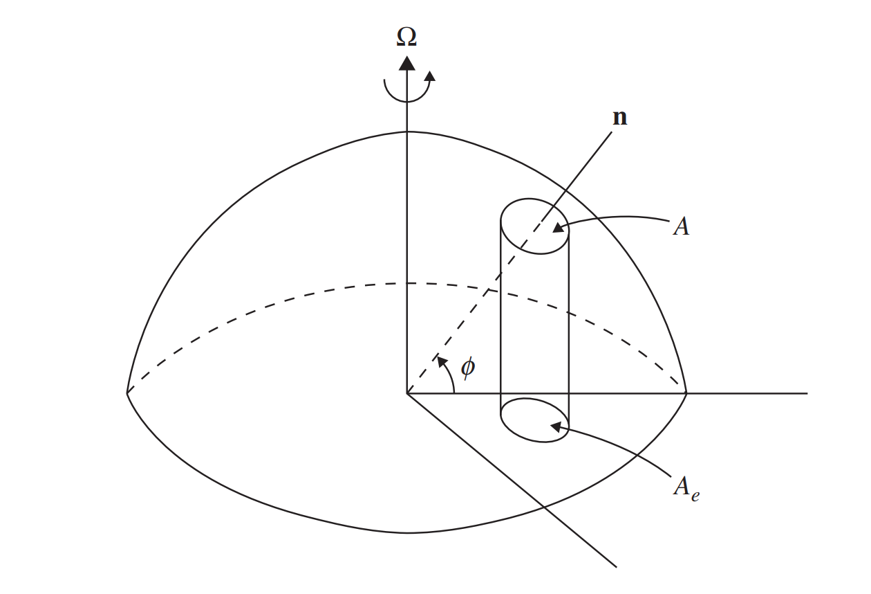
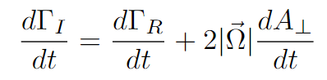
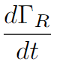
AMATH463: Fluid Dynamics
Effects of beta drift on circulation
Petra M. Duff & David René
We can then take the time derivative, for which we obtain:
Given that = 0, we have that the inertial circulation must increase as the projected area increases.
Projected area increases when our system moves in latitude.

Slide 15
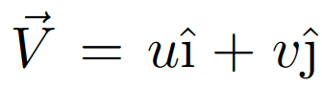
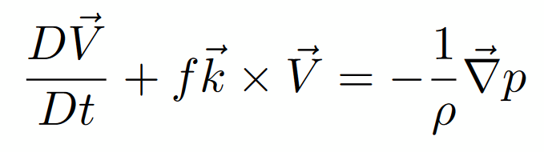
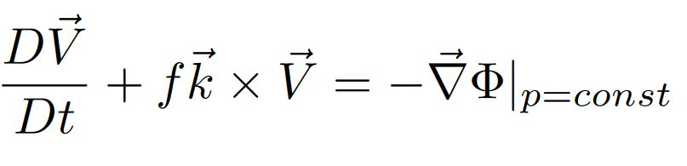
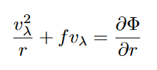
AMATH463: Fluid Dynamics
Dynamics of Mature Hurricanes
Petra M. Duff & David René
Main assumption: axial symmetry
To take advantage, we put our f-plane equations:
in vector form, for
then in terms of the geopotential 𝛷=gh using the hydrostatic equation
and then in cylindrical coordinates

Slide 16
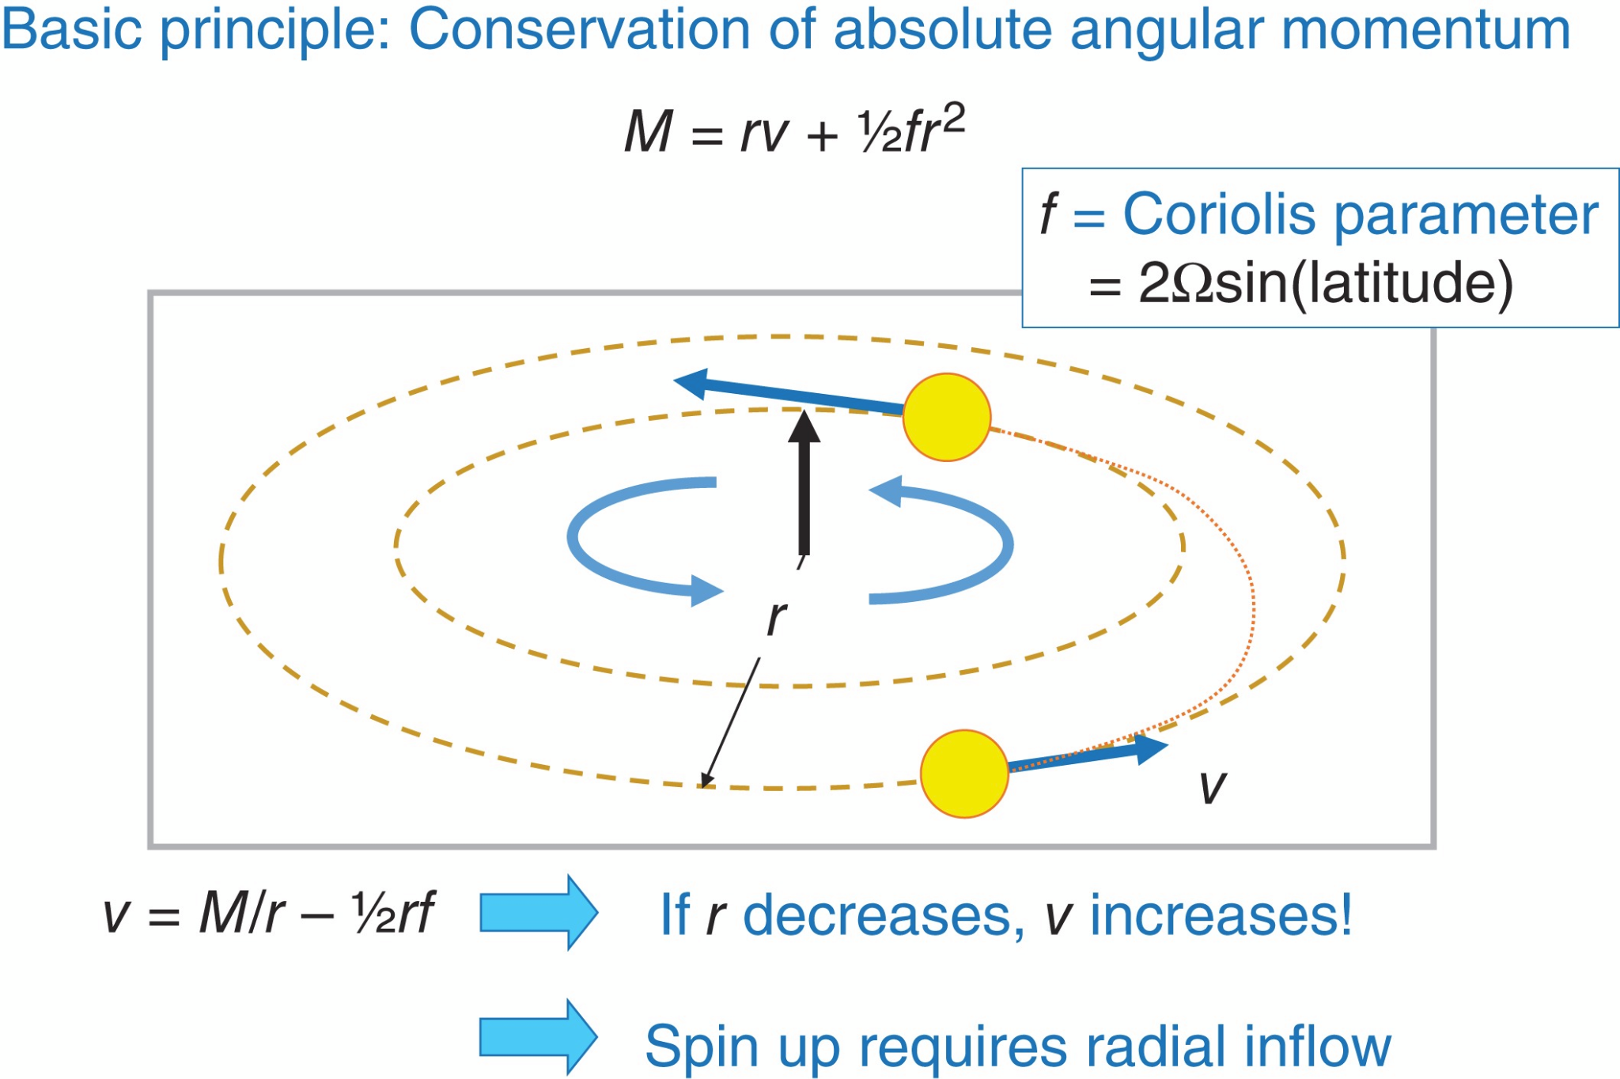
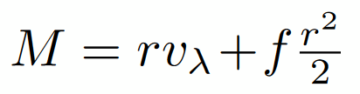
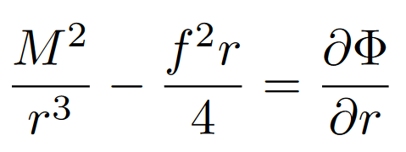
AMATH463: Fluid Dynamics
Dynamics of Mature Hurricanes
Petra M. Duff & David René
Angular momentum
is conserved, so we can write
our governing equation for angular momentum of the hurricane.
Smith & Montgomery, 2016

Slide 17
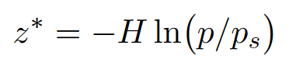
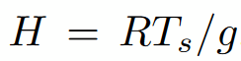
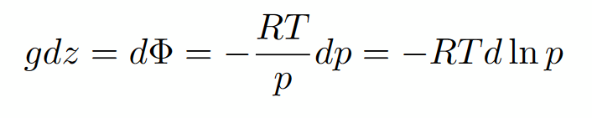
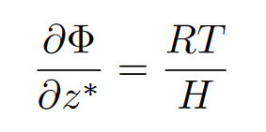
AMATH463: Fluid Dynamics
Dynamics of Mature Hurricanes
Petra M. Duff & David René
Log-pressure coordinates:
where p_{s} is a reference pressure and for global average temperature T_{s}
So using the ideal gas law,

Slide 18
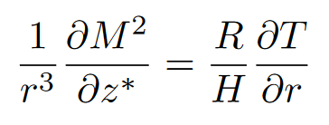
AMATH463: Fluid Dynamics
Dynamics of Mature Hurricanes
Petra M. Duff & David René
This gives us the relationship between the radial temperature profile and the vertical shear of the angular momentum.
Vertical wind shear can change the structure of the vortex, so this is an interesting relationship to consider.

Slide 19
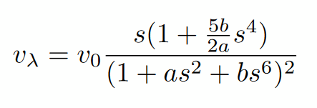
AMATH463: Fluid Dynamics
Radial temperature from modeling tangential velocity
Petra M. Duff & David René
Can we get the temperature profile knowing the wind velocity?
Let’s model the hurricane using
uniform vertical shear flow + axisymmetric barotropic vortex
which has the tangential velocity profile

Slide 20
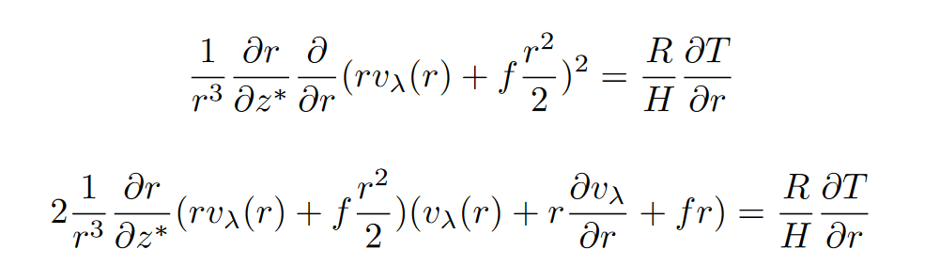
AMATH463: Fluid Dynamics
Radial temperature from modeling tangential velocity
Petra M. Duff & David René
Knowing the expression for the angular momentum M,

Slide 21
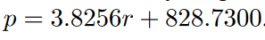
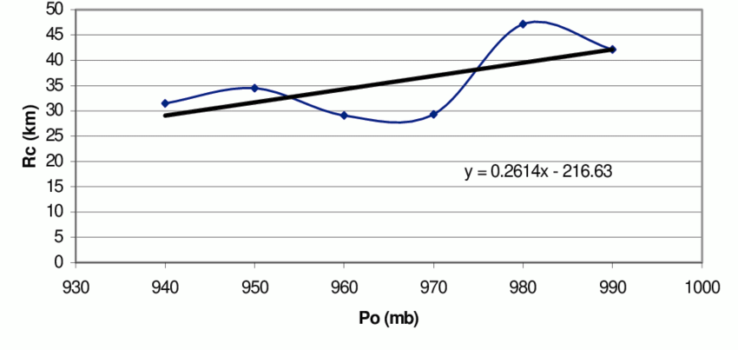
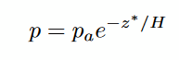
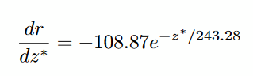
AMATH463: Fluid Dynamics
Radial temperature from modeling tangential velocity
Petra M. Duff & David René
So we have the relation
Silvia et al., 2001

Slide 22
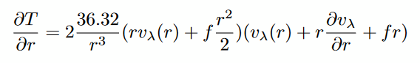
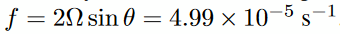
AMATH463: Fluid Dynamics
Radial temperature from modeling tangential velocity
Petra M. Duff & David René
So our final expression is
Since we are using an expression for p for the Mexican Pacific Ocean, we use a latitude of 20° and

Slide 23
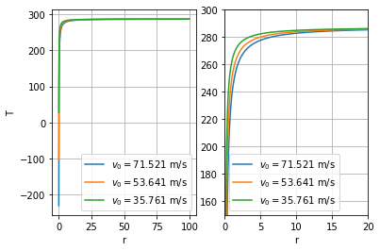

AMATH463: Fluid Dynamics
Dynamics of Mature Hurricanes
Petra M. Duff & David René

Slide 24

AMATH463: Fluid Dynamics
Conclusion
Petra M. Duff & David René
Hurricane formation is an ever changing topic with many of its mechanism still not fully explained: for example, how the eye of the storm is created and maintained, how vertical wind shears inhibits hurricane formation and what decides whether a tropical depression with the right conditions becomes a hurricane or not are all unclear subjects even today.
Despite the complexity of the subject matter, we were able to identify many of the mechanisms that drive the formation of hurricanes: from fluid mechanics to thermodynamics. Topics of the latter were not deeply investigated as they were not part of the scope of this course and project, however we were able to come up with a simple toy model for the temperature profile in a hurricane with the knowledge of its tangential wind speed.

Slide 25
AMATH463: Fluid Dynamics
Next Steps
Petra M. Duff & David René
Investigate the fluid mechanics of the eyewall
Further computational investigation and numerical modeling for the mechanics presented
R. K. Smith and M. T. Montgomery, as well as K. Ooyama provide useful information for these next steps.

Slide 26
AMATH463: Fluid Dynamics
References
Petra M. Duff & David René
[1] Hurricane costs,” NOAA Office for Coastal Management.
[2] F. Nebeker, Calculating the Weather: Meteorology in the 20th Century. ISSN, Elsevier Science, 1995.
[3] “Hurricane development: From birth to maturity,” Hurricanes.
[4] I. Cohen, P. Kundu, and H. Hu, Fluid Mechanics. Elsevier Science, 2004.
[5] J. R. Holton and G. J. Hakim, Introduction to dynamic meteorology, Chapter 9.7: Hurricanes, p. 312–321. Aca-
demic Press, 5th ed., 2019.
[6] “Severe weather information centre,” SWIC.
[7] R. K. Smith and M. T. Montgomery, “Understanding hurricanes,” Meteorological Institute, Ludwig Maximilians
University of Munich, 2017.
[8] P. D. Reasor and M. T. Montgomery, “Evaluation of a heuristic model for tropical cyclone resilience,” Journal of
the Atmospheric Sciences, vol. 72, no. 5, pp. 1765–1782, 2015.
[9] M. Riemer, M. T. Montgomery, and M. E. Nicholls, “Further examination of the thermodynamic modification of
the inflow layer of tropical cyclones by vertical wind shear,” Atmospheric Chemistry and Physics, vol. 13, no. 1,
pp. 327–346, 2013.
[10] S. C. Jones, “The evolution of vortices in vertical shear. I: Initially barotropic vortices,” Quarterly Journal of the
Royal Meteorological Society, vol. 121, no. 524, pp. 821–851, 1995.
[11] R. Silva, G. D ́ıaz-Hern ́andez, A. Pedrozo-Acu ̃na, P. Salles, and B. Aguilar, “Oceanographic risk from hurricanes
on the Mexican Pacific Coast,” 07 2001.
[12] K. Ooyama, “Numerical simulation of the life cycle of tropical cyclones.,” Journal of Atmospheric Sciences,
vol. 26, pp. 3–40, Jan. 1969.
[13] D. Acheson, Elementary Fluid Dynamics. Comparative Pathobiology - Studies in the Postmodern Theory of
Education, Clarendon Press, 1990.
[14] D. Randall, General Circulation Model Development: Past, present, and future. Academic Press, 1st ed., 2011.
[15] H. Riehl, “A model of hurricane formation,” Journal of Applied Physics, vol. 21, no. 9, pp. 917–925, 1950.

Slide 27
Any Questions?
Thank you!

